Slide 1
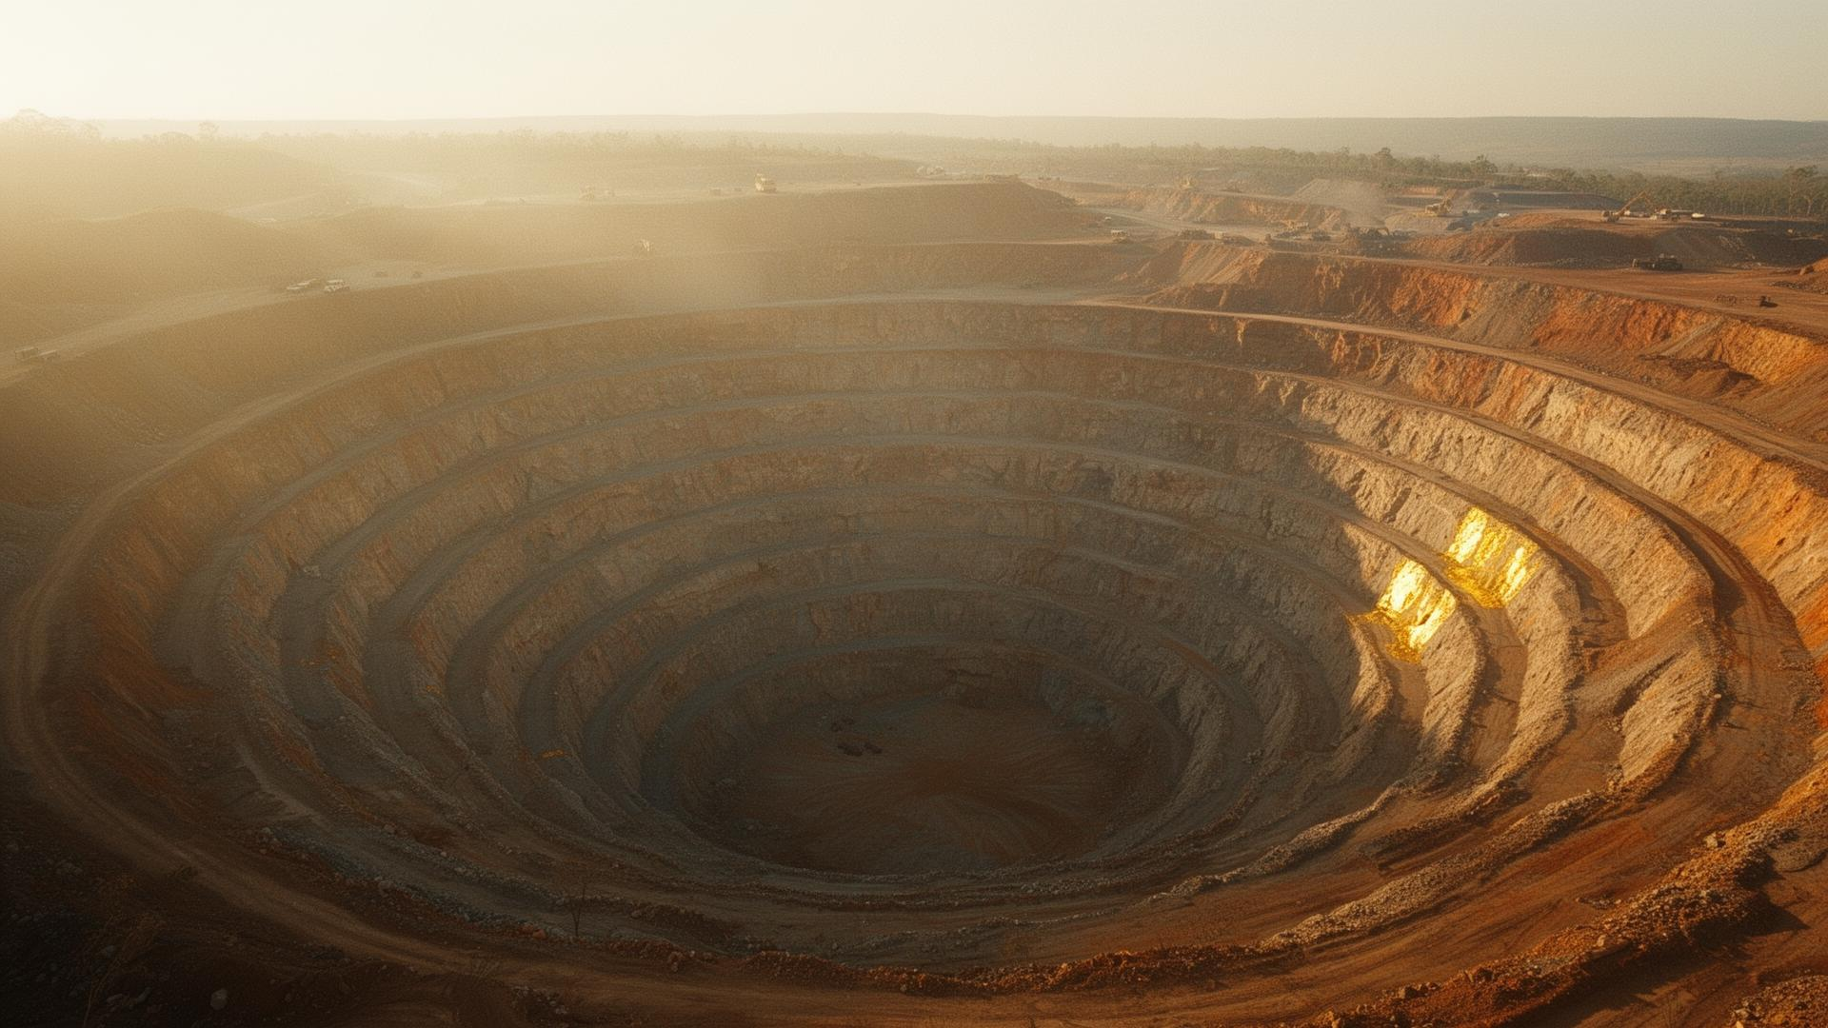

I N V E S T O R P R E S E N T A T I O N
A company,
in its own hand.
Producing gold operations across China, Africa,
Australia and Canada.
Q4 2025 · TSXV : MJS
C O V E R

Slide 2
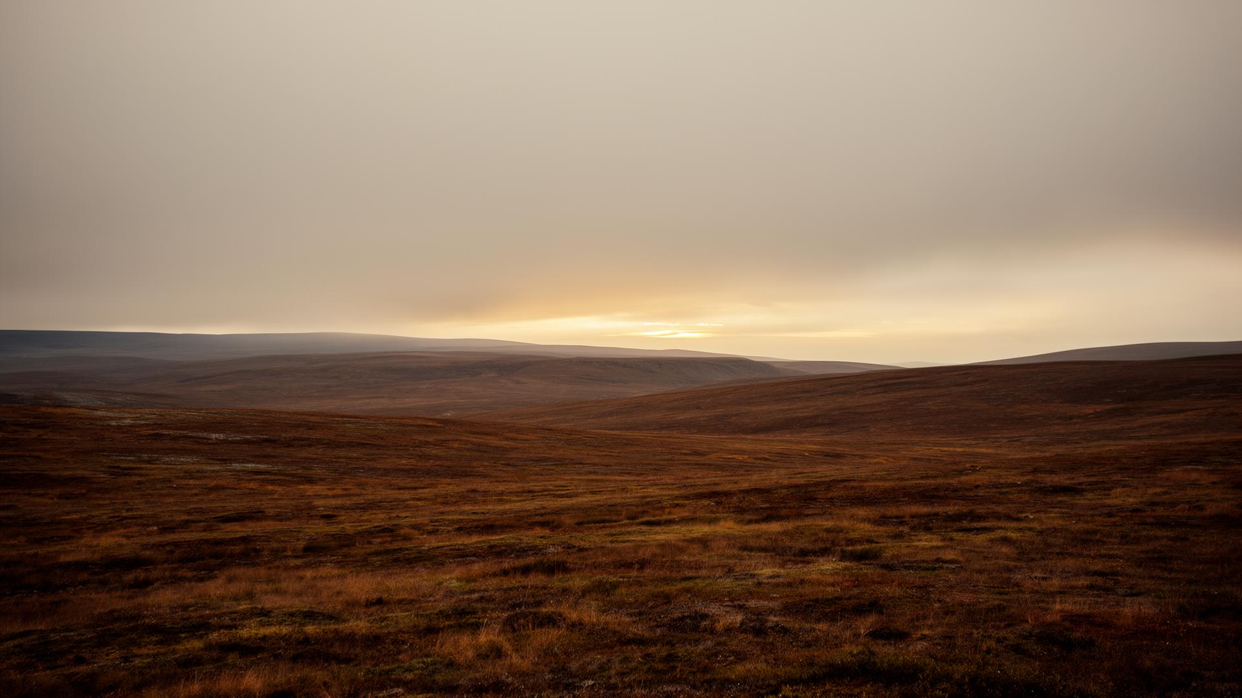
T O D A Y
Agenda.
01
The company at a glance
02
Operating portfolio
03
Production & financials
04
Sustainability & governance
05
Outlook & capital plan
06
Q & A
Pilbara horizon, dusk.
A G E N D A

Slide 3
S E C T I O N T W O
The operating
portfolio.
Five landscapes shaped our craft.
S E C T I O N

Slide 4
O P E R A T I O N S
Songjiagou
shapes the year.
Our cornerstone open-pit and underground operation in Shandong Province delivered 28,400 oz in Q4 — ahead of guidance — with all-in sustaining costs holding inside the upper half of the industry's first quartile.
Underground development resumed on schedule in November after the planned mill relining campaign, and the Phase III stope design was approved in December for a 2026 ramp-up.
Plate one — open-pit, dawn light.
O P E R A T I O N S

Slide 5
Q 4 2 0 2 5 H I G H L I G H T S
The year in figures.
P R O D U C T I O N , Q 4
A I S C
R E S E R V E S
S H A R E , C L O S E
28,400
1,287
1.2M
0.145
oz
US$/oz
oz
C$
+6.4% vs guide
−$48 YoY
Songjiagou
−3.33%
Unaudited. Reconciliation to IFRS in the appendix.
D A T A

Slide 6
P R O J E C T · C H I N A
Songjiagou
Shandong Province, China · Open-pit + underground
R E S O U R C E
G R A D E
M I N E L I F E
Our cornerstone gold operation, set in one of the world's most prolific districts. A 14-year mine life with patient room for grade improvement.
1.2M oz
0.78 g/t
14 yrs
P R O J E C T P R O F I L E

Slide 7
M A N A G E M E N T
Stewards, not operators.
Stephen Kenwood
James Mackie
P . G E O . — P R E S I D E N T & C E O
C P A , C G A — C F O & C O R P O R A T E S E C R E T A R Y
Registered with APEGBC; B.Sc. (Geology), UBC. Project experience spans the Snip and Eskay Creek gold deposits in B.C., the Petaquilla Cu–Au porphyry in Panama, and work in Peru, Chile, and China. 20+ years with public companies; currently an independent director of five TSXV issuers.
Mining finance executive with 25+ years across Canada, the U.S., South America, Africa, and China. Member of the CGA of British Columbia and Canada. Deep background in financial management, equity financings, corporate governance, and securities compliance.
L E A D E R S H I P

Slide 8
M I N E P L A N
Phase II, against Phase III.
P H A S E I I — C U R R E N T
P H A S E I I I — A P P R O V E D
Method
Open-pit, conventional truck/shovel
Method
Underground sublevel stoping
Throughput
8,500 t/d
Throughput
11,200 t/d
Strip ratio
2.4 : 1
Strip ratio
n/a
AISC
US$ 1,287 / oz
AISC
US$ 1,150 / oz (target)
Mine life
to 2027
Mine life
extends to 2041
C O M P A R I S O N

Slide 9
Q 4 2 0 2 5 — S E L E C T E D M E T R I C S
Financial summary.
Metric | Q4 2025 | Q4 2024 | Change
Production (oz) | 28,400 | 26,700 | +6.4%
Revenue (US$M) | 57.6 | 52.3 | +10.1%
AISC (US$/oz) | 1,287 | 1,335 | −3.6%
Adjusted EBITDA (US$M) | 21.4 | 17.9 | +19.6%
Free cash flow (US$M) | 11.8 | 9.4 | +25.5%
Cash balance (US$M) | 82.1 | 73.6 | +11.5%
Comparatives unaudited. See appendix for full reconciliation to IFRS.
F I N A N C I A L S

Slide 10

F R O M T H E F I E L D
“The land does not negotiate.
It records.”
— From the 2025 Sustainability Report
Q U O T E

Slide 11
Thank you.
Majestic Gold Corp.
#1730 — 1188 West Georgia Street, Vancouver BC V6E 4A2
info@majesticgold.com · +1 604 569 3392
T S X V : M J S · F S E : M J T
T H A N K Y O U

